Slide 1
Whole plant processes
Growth, allocation, life cycles, phenology

Slide 2
Spicoli question of the day: Why do plants grow?

Slide 3
Allocation

Slide 4
Allocation
The distribution of growth to different organs
Allometry: the relative size of different organs
High leaf allocation
High stem allocation

Slide 5
Following the carbon

Slide 6
CO₂
Carbon is first taken up by photosynthesis (source)

Slide 7
The sugars are then transported throughout the plant (sinks)

Slide 8
Sucrose, not glucose, is the primary transport sugar…huh?
Sucrose
Glucose
Notes:
Aldehyde group of glucose is easily oxidized (reacts with others) and is also attracted to enzymes

Slide 9
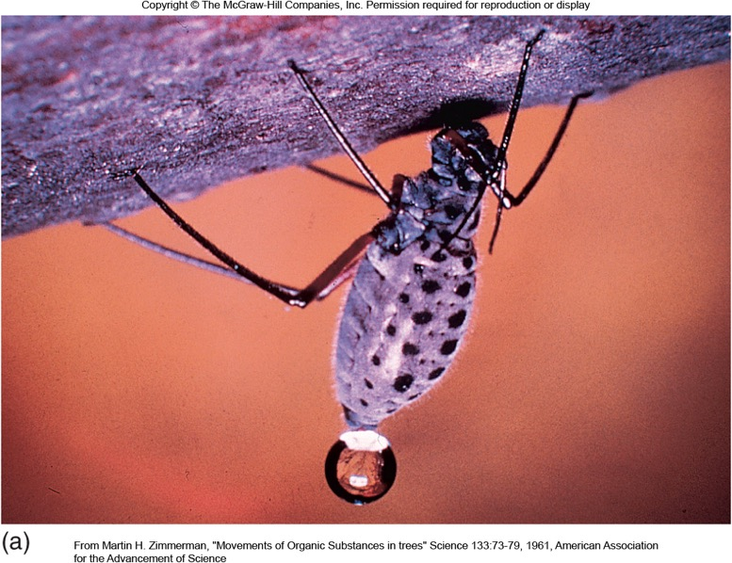
Translocation
Movement of food substances through the plant (via water)
Translocation happens fast!
(Can’t be accounted for by diffusion alone)

Slide 10
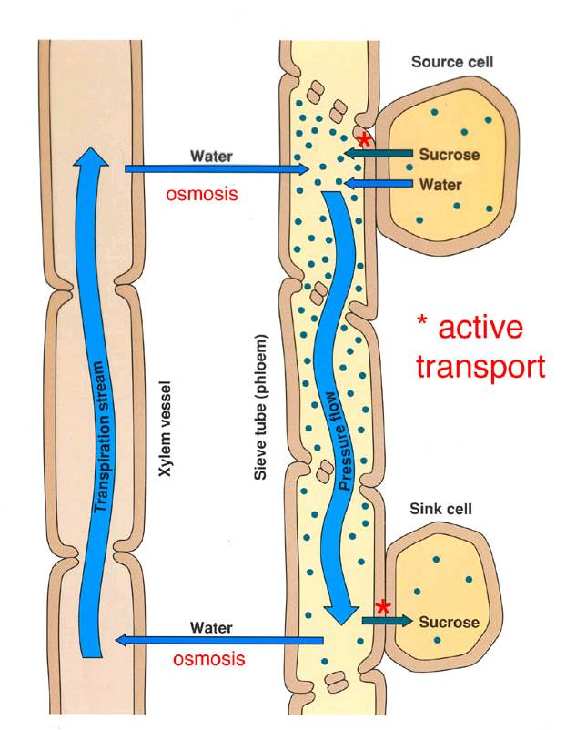
Pressure-flow hypothesis
Food is actively loaded into phloem from “source”
Water enters phloem from xylem via osmosis
Pressure gradient drives food to “sink”
Food is actively removed from sink

Slide 11
What do the sugars from photosynthesis get used for? (What are the sinks?)

Slide 12

Allocation is a dynamic process that is dependent on the environment
Leaves
Stems
Roots
Environmental change
Farrior et al. (2013)

Slide 13
In isolation, how would abiotic conditions influence allocation?
Light
Temperature
Water
CO₂
Nutrients
NASA

Slide 14
In isolation, how would life history traits influence allocation?
Lifespan
Ontogeny
Photosynthetic pathway
Microbial symbiosis

Slide 15
Source/sink controversy

Slide 16


Slide 17
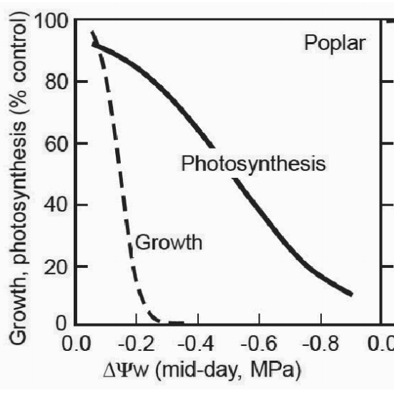
Water availability constrains growth more than photosynthesis
Körner (2003)

Slide 18
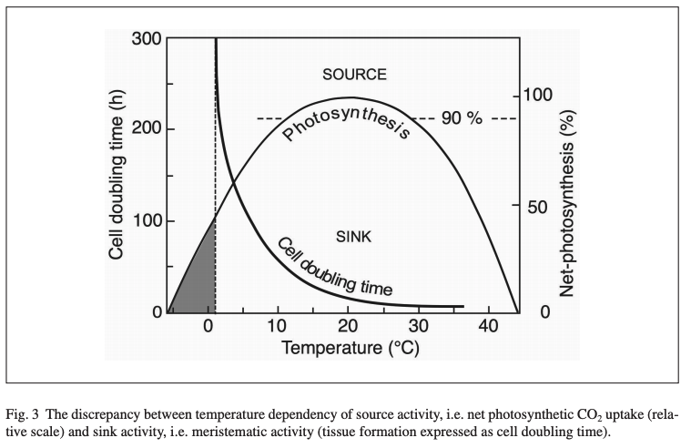
Low temperature constrains growth more than photosynthesis
Körner (2003)

Slide 19
So under low resource availability, we might expect low growth to result in reduced photosynthesis, as more photosynthesis would be wasteful

Slide 20
Overarching thesis – photosynthesis matches sink strength

Slide 21
Overarching thesis – photosynthesis matches sink strength
How could you test this??

Slide 22
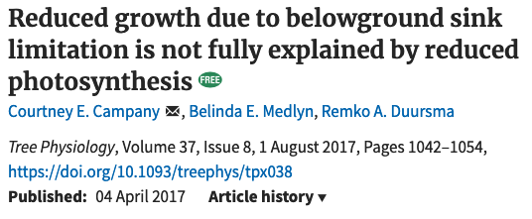

Slide 23
Plant growth decreased by 84%
Campany et al. (2017)

Slide 24
Allocation was similar
Campany et al. (2017)

Slide 25
Photosynthesis only decreased by 26%, but there was a big change in carbon use efficiency
Growth per whole-plant photosynthesis
Campany et al. (2017)

Slide 26
Conclusion: sink strength does influence photosynthesis, but this does not fully explain sink-limited growth reductions

Slide 27
Some things that need considered
Photosynthetic acclimation
Whole-plant- versus leaf-level photosynthesis
Within-leaf and whole-plant allocation of nutrients

Slide 28
Life cycles

Slide 29
Seeds and germination

Slide 30
Not all plants have seeds! What’s the benefit?

Slide 31
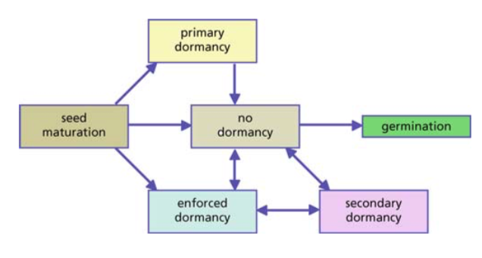
Dormancy - not all seeds germinate immediately

Slide 32
Two primary benefits of dormancy
Avoid poor growth conditions
Avoid competition

Slide 33
Two primary benefits of dormancy
Avoid poor growth conditions
Avoid competition
Knowing this, what would be the important cues to respond to? (Let’s make a list)

Slide 34
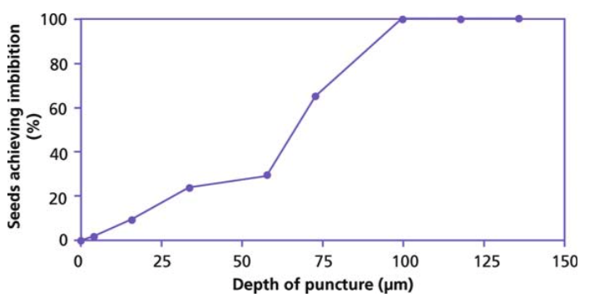
Water – some plants will only imbibe after seed coat is worn down

Slide 35
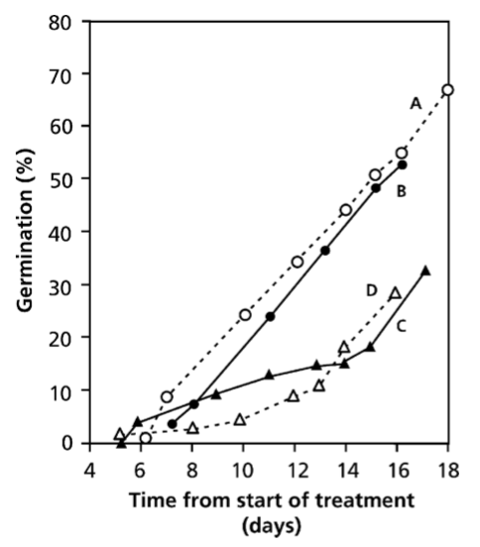
Water soluble inhibitors can also prevent germination during dry times
93 hours of watering
24 hours of watering

Slide 36
Light influences germination in 3 ways
A total light requirement
Intensity and duration
Spectral compositions of light

Slide 37
Light influences germination in 3 ways
A total light requirement
Avoid being buried too deep in the soil (fatal germination)
When soil is turned over, seeds emerge
Intensity and duration
Spectral compositions of light

Slide 38
Light influences germination in 3 ways
A total light requirement
Intensity and duration
Take advantage of disturbance
Spectral compositions of light

Slide 39
Light influences germination in 3 ways
A total light requirement
Intensity and duration
Spectral compositions of light
Plants can sense what is happening above them!

Slide 40
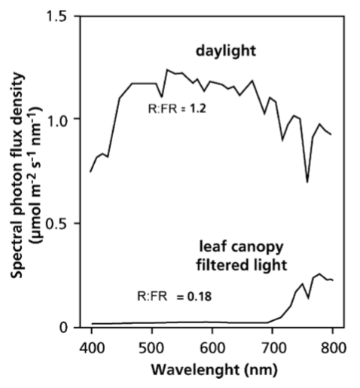
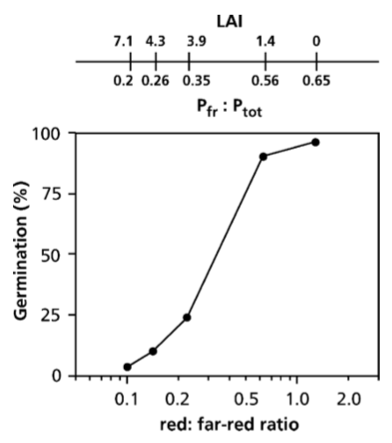

Slide 41
Temperature influences dormancy in two ways
Absolute temperature
Temperature fluctuations

Slide 42
Temperature influences dormancy in two ways
Absolute temperature
Cue to germinate at optimal time in season
Temperature fluctuations

Slide 43
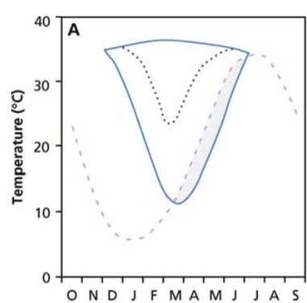
Summer Annual
Maximum T in field
Minimum T for
germination

Slide 44
Temperature influences dormancy in two ways
Absolute temperature
Temperature fluctuations
Mechanism to sense soil depth

Slide 45
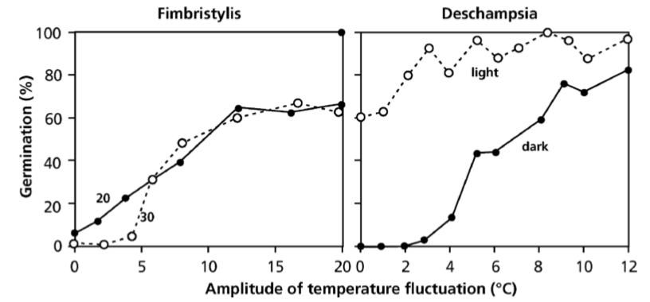

Slide 46
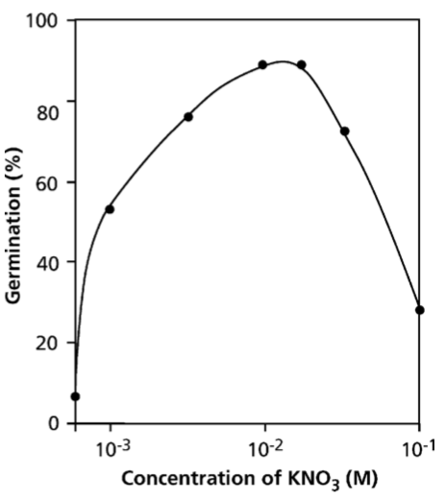
Presence of nitrate can signal competition
More NO₃ = less competition

Slide 47
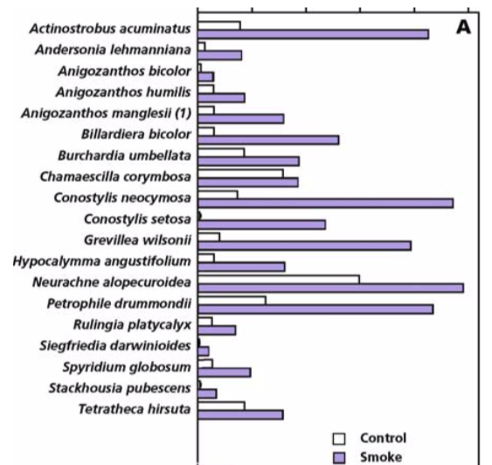
Smoke can also enhance germination

Slide 48
Mechanism for dormancy release

Slide 49
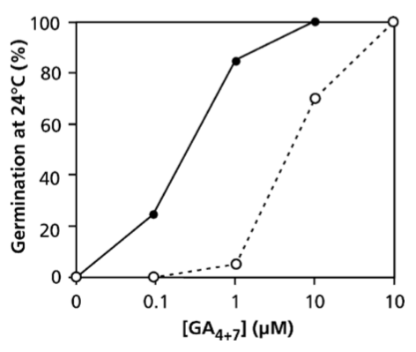
Dormancy release signals: an increase in the ratio of giberrelic acid (GA) to absciscic acid (ABA)

Slide 50
Summary

Slide 51
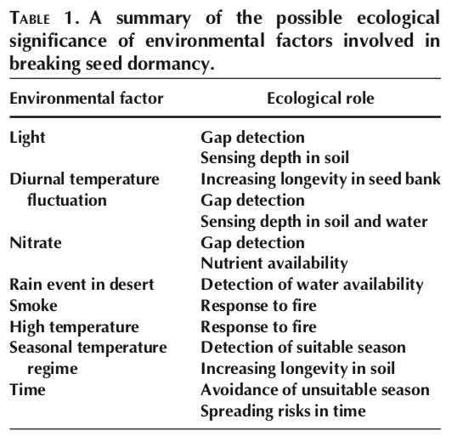

Slide 52
Seedling/juvenile phase

Slide 53
Being a seedling is tough
Low light
Prone to desiccation
Resources determined by seed size

Slide 54
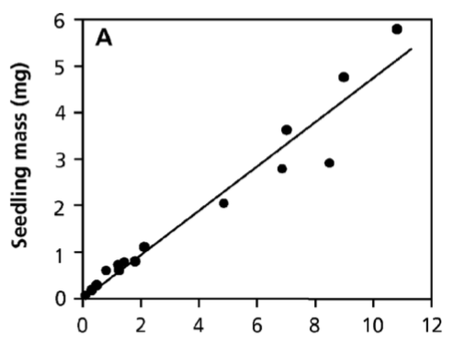
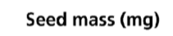
Seed size trade-offs
Bigger seeds = bigger seedlings

Slide 55
Seed size trade-offs
What’s the tradeoff??

Slide 56
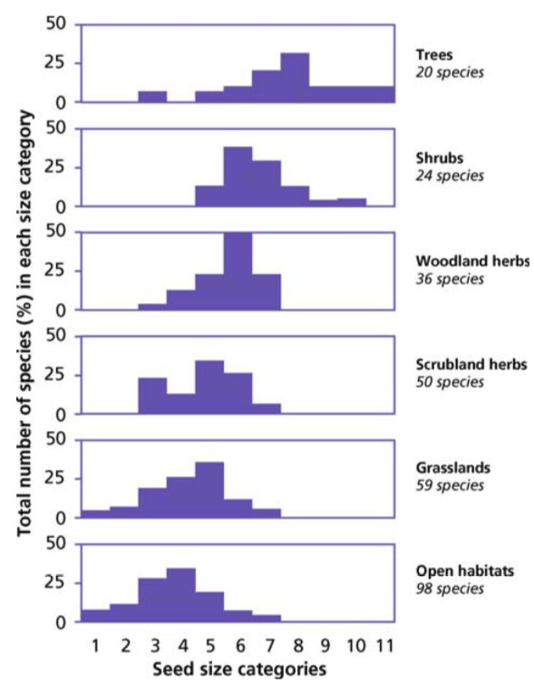

Slide 57
Reproductive phase

Slide 58
Cost of reproduction
Flowering and fruiting: up to 30% of NPP
Median: 10%
In some cases, can require large storage reserves
Trade-off between vegetative and reproductive growth

Slide 59
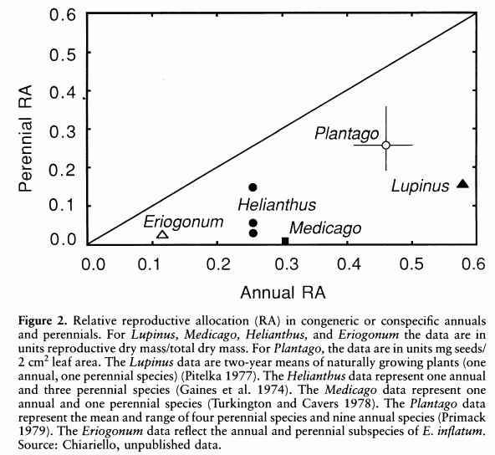
Bazzaz et al. (1987)

Slide 60
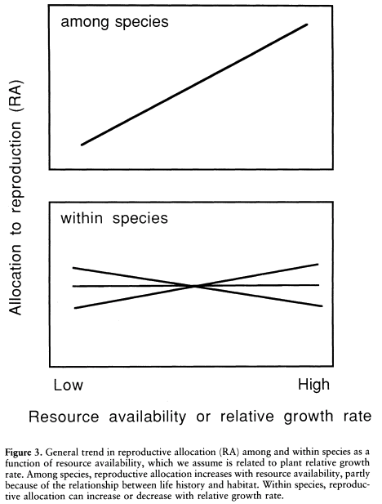
Bazzaz et al. (1987)

Slide 61
Generally the cost of female structures is greater than males structures
Carbon allocation to female flowers can be 3x a male flower (Lambers book)
Nitrogen difference may be even greater

Slide 62
Some plants can reproduce vegetatively
Carbon cost to reproduce sexually can be 10,000-fold greater than asexual reproduction in some places
Why don’t all plants reproduce asexually?
Larrea tridentata

Slide 63
Life cycle diversity

Slide 64
Timing of development
Annuals
Perennials
Bi-ennials
Where would you expect each to dominate?

Slide 65
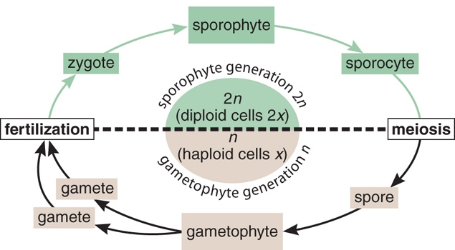
Time spent as a gametophyte
Bryophytes are gametophyte (1n) dominant
What’s the advantage of sporophyte dominance?

Slide 66
Phenology

Slide 67
What are the benefits of being deciduous or evergreen?

Slide 68
What are the costs of being deciduous or evergreen?

Slide 69
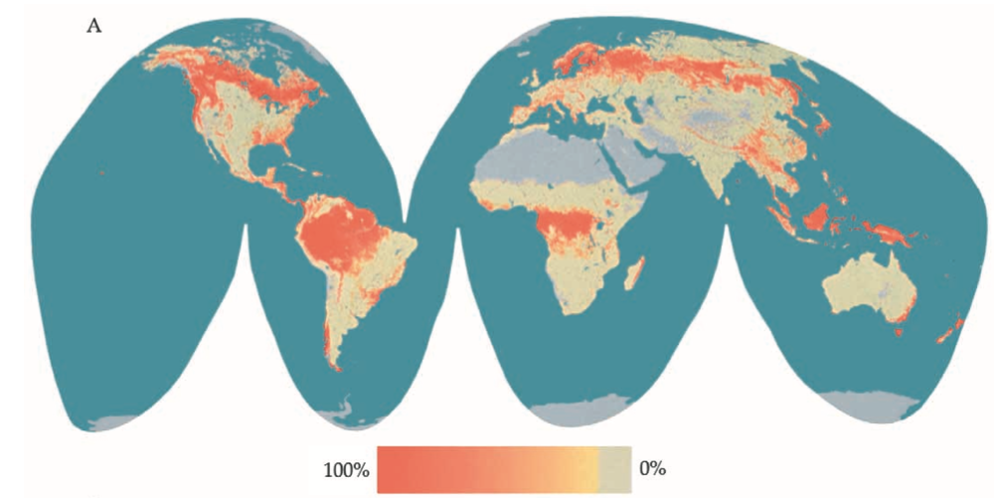
Bimodality of phenological strategies
Many evergreens in high and equatorial latitudes, but not so many in mid latitudes
Evergreenness
Givnish (2002)

Slide 70
Givnish’s paradoxes
Why are boreal forests dominate by evergreens when they are exposed to intense thermal seasonality and winter drought?
Why do deciduous larches often dominate nutrient-poor bogs and swamps in the boreal zone?
Why do evergreen leaf exchanges dominate nutrient-poor sites in the seasonally dry subtropics?
Givnish (2002)

Slide 71
The importance of leaf phenology

Slide 72
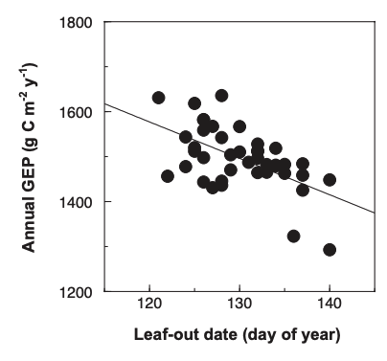
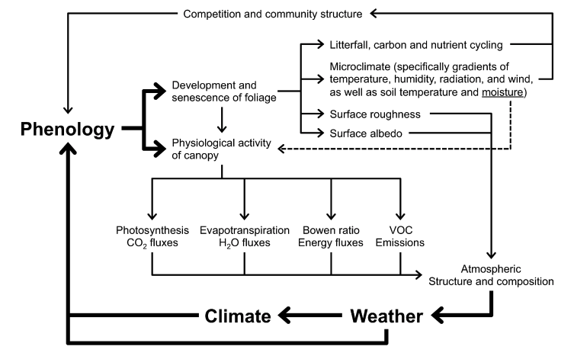
Richardson et al. (2013)

Slide 73
The timing of leaf phenology

Slide 74
In temperate regions, temperature determines Spring leaf out
Keenan et al. (2014)

Slide 75
Water is more important in tropical climates
Xu et al. (2016)

Slide 76
Autumn phenology is much harder to predict…
maybe determined by spring phenology?
Keenan et al. (2015)

Slide 77
Class activity: the Invader
Miniquiz question
Pretend you are a species of plant
Dr. Smith will give you a place to invade
What growth and reproductive strategy will you adopt?
What would your allocation pattern be like?
Things to think about:
What is the environment like?
Natural enemies?
Competitors?
What kind of flowers/seeds?

Slide 78
Joshua Tree NP (CA)
Big Bend NP (TX)
Congaree NP (SC)
Everglades NP (FL)
Smokey Mtns NP (TN)
Badlands NP (SD)
Rocky Mountain NP (CO)
Sequoia NP (CA)
Acadia NP (ME)

